Slide 1
Data Science
Session – 3
Date – 13th May, 2022

Slide 2
Python Tuple
The Python Tuple is almost similar to a List except that these are immutable, and Lists are mutable. It means Once we declare the Python Tuple, we cannot change the values or items inside it, something like Constant keyword in other programming languages.
A Python Tuple is a sequence of multiple values in an ordered sequence. Tuples are declared using Open and Closed Parenthesis ( ). Unlike Strings, Python Tuple allows us to store different types of data such as integer, float, string, etc.
To declare an empty Tuple in Python that contains no values, use TupleName = ().
StringTup = (‘apple’, ‘Orange’, ‘Grape’, ‘Mango’) is a string tuple that contains four string values.
MixedTup = (‘apple’, 2, 3.50, ‘Mango’) is a mixed one that contains one integer, one float, and two integer values.
NestedTup = (‘Gateway’, ‘Tutorial’, (1, 2, 3) ) is an example of one inside another (Nested).
ListTup = (‘Py’, ‘Tutorial’, [1, 2, 3] ) is an example of List inside it.

Slide 3
Python Tuple Methods
Sum(tuple)
Len(tuple)
Min(tuple)
Max(tuple)
Sorted(tuple)
Index(element)
Count(element)
Tuple(list)

Slide 4
Python Set
A Python set data type is similar to Lists. However, it does not accept duplicate items (unique values). It is an unordered collection of zero or more items, which are unindexed (no index position).
Python Sets allows mutable items, so adding and removing items is very easy. However, slicing is not possible because of no index. Generally, Python sets are very useful to perform mathematical operations like Union, Intersections, comparisons, and differences.
In Python, it can be created by placing the required items inside curly braces or using the set() function without any arguments. It allows you to place different kinds of data type items like integer, string, etc., in a single one. The following is the available list of ways to declare them.
S1 = {}

Slide 5
Insert items in set
add(x): Add one item to the existing one in Python.
update(): Add multiple items to the existing one.

Slide 6
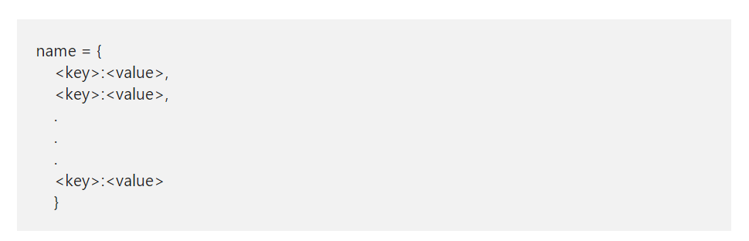
Python Dictionary
A Python Dictionary is a collection which is unordered, changeable, and indexed. Unlike a string, it is mutable. So, the Python dict can expand or sink.
We can declare a Python Dictionary by simply placing empty parenthesis, or using the dict(). The syntax for declaring a dictionary

Slide 7
How to Access Python Dictionary items?
Though, dictionary is an unordered collection, we can access the values using their keys. It can be done by placing the key in the square brackets or using get function. If we access non-existing one, the get function with return none. Whereas placing the key inside a square brackets method throw an error
Dname[key] or Dname.get(key)

Slide 8
Insert and Update Python Dictionary items
Remember, dicts are mutable so, you can insert or update any element at any point in time. Use below syntax to insert or update values.
DName[key] = value
If a key is present, it updates the value. If DName does not have the key, then it inserts the new one with the given.
Pop(element)

Slide 9
More functions for dictionary
Da.values()
Da.key()
The copy functions shallow copy the given dict into a completely new one. You can also place a it inside a list.
The pop method removes the value at a given key, and prints the removed item. The Python pop item removes the last inserted item (key, value pair).

Slide 10
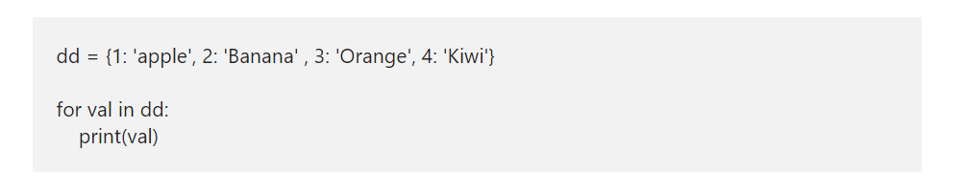
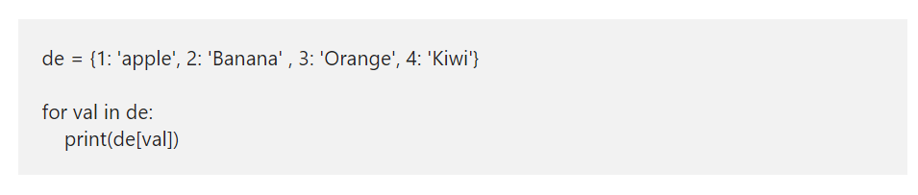
Dictionary Contd.

Slide 11
Python Dictionary Methods
clear() removes all the elements.
copy() shallow copy.
fromkeys() returns a new one, where keys start from a sequence and equal to values.
get() value of a Given Key.
items() returns a list containing the items (keyvalue pairs)
keys() Prints a list of keys.
pop() remove and print the item of a given key. Use to delete.
popitem() removes and prints the last inserted keyvalue pair.
setdefault() – If the given key is present, it returns its value. If not, this function inserts a key with a given value and prints that.
update() updates the KeyValue pair.
values() returns the list of all the values.

Slide 12
NUMPY

Slide 13
Python numpy Aggregate Functions
In the Python numpy module, we have many aggregate functions or statistical functions to work with a single-dimensional or multi-dimensional array. The Python numpy aggregate functions are sum, min, max, mean, average, product, median, standard deviation, variance, argmin, argmax, percentile, cumprod, cumsum, and corrcoef.

Slide 14
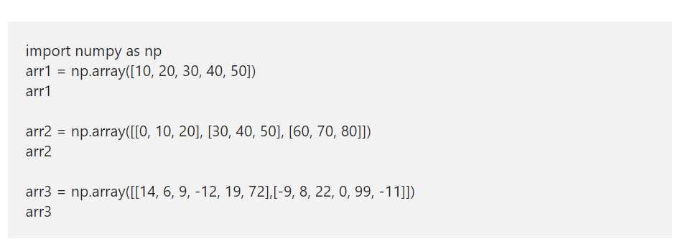
Python numpy Aggregate Functions
To demonstrate these Python numpy aggregate functions, we use the below-shown arrays.

Slide 15
Python numpy sum
Python numpy sum function calculates the sum of values in an array.
Ex – arr1.sum()
This Python numpy sum function allows you to use an optional argument called an axis. This Python numpy Aggregate Function helps to calculate the sum of a given axis. For example, axis = 0 returns the sum of each column in an Numpy array. axis = 1 returns the sum of each row in an array
Ex – arr2.sum(axis = 0)

Slide 16
Python numpy average
Python numpy average function returns the average of a given array.
Ex – np.average(arr1)
Average of x and Y axis
Ex- np.average(arr1, axis = 0)

Slide 17
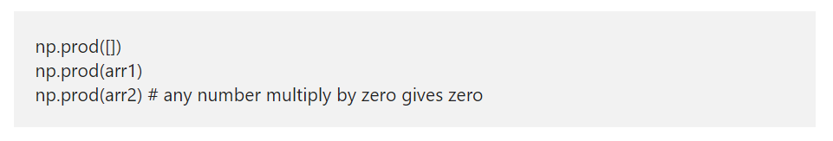
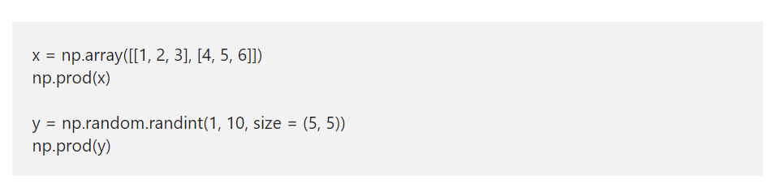
Python numpy prod
Python numpy prod function finds the product of all the elements in a given array. This numpy prod function returns 1 for an empty array

Slide 18
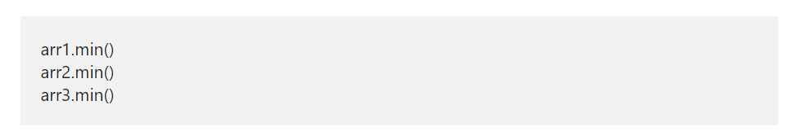
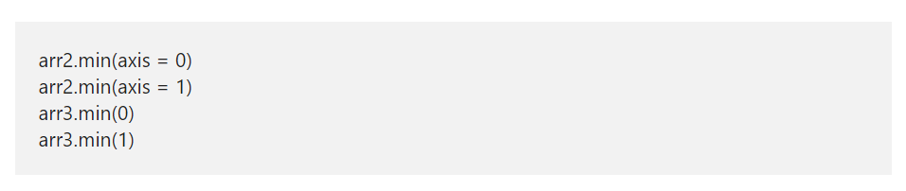
Python numpy min
The Python numpymin function returns the minimum value in an array or a given axis.

Slide 19
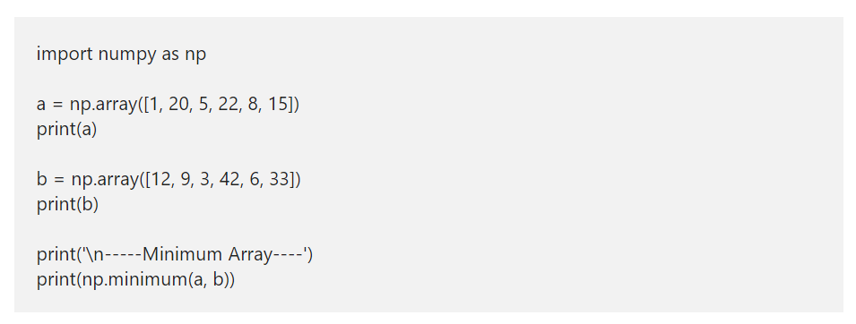
Python Array minimum

Slide 20
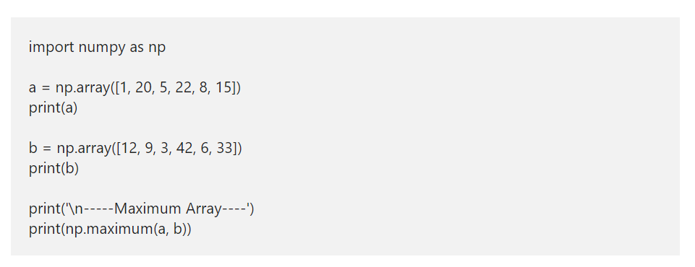
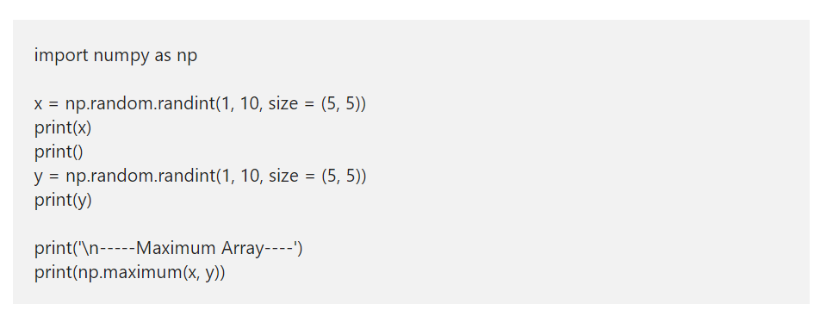
Python numpy Array maximum

Slide 21
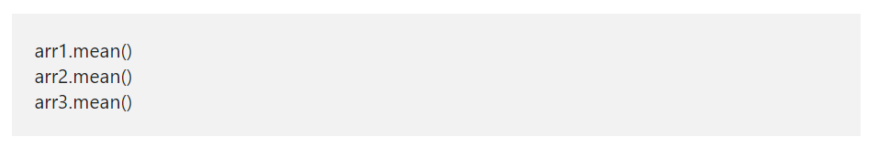
Python numpy mean
Python numpy mean function returns the mean or average of a given array or in a given axis. The mathematical formula for this numpy mean is the sum of all the items in an array / total array of elements.

Slide 22
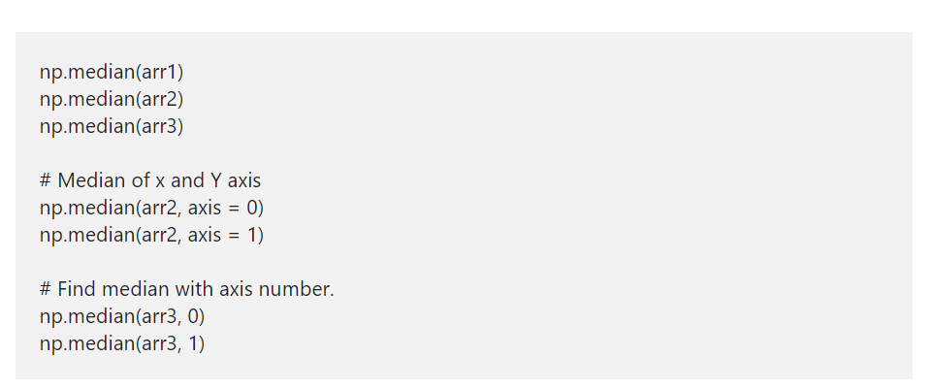
Python numpy median

Slide 23
Python numpy Arithmetic Operations
Python numpy module provides various arithmetic functions such as add, subtract, multiply and divide, which performs Python numpy arithmetic operations on arrays. Apart from them, you can use the standard Python Arithmetic Operators also. Arrays should be of the same shape, or they have to bound to array rules to use numpy arithmetic functions.
We use the below arrays to demonstrate the Python numpy Arithmetic Operations using arithmetic functions and arithmetic operators

Slide 24
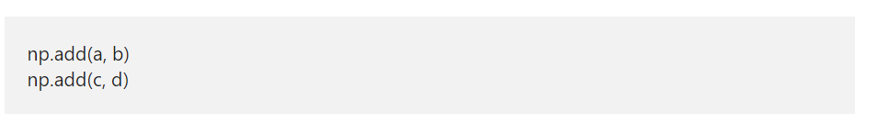
Python numpy add function

Slide 25
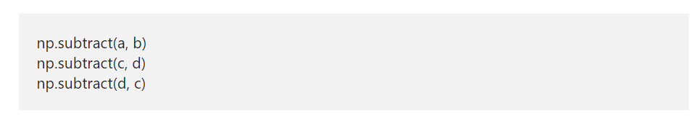
Python numpy subtract function

Slide 26
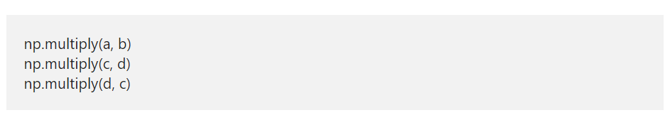
Python numpy multiply function

Slide 27
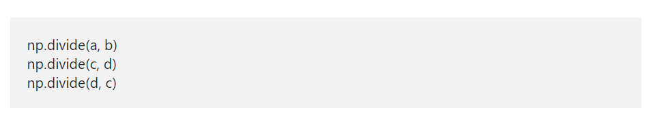
Python numpy divide function

Slide 28
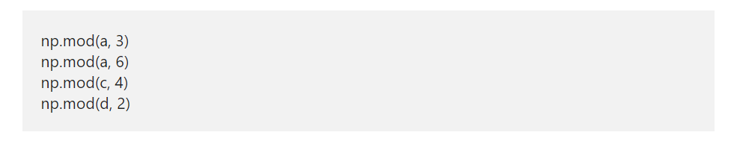
Python numpy mod function
The Python numpy mod function returns the remainder of the division.

Slide 29
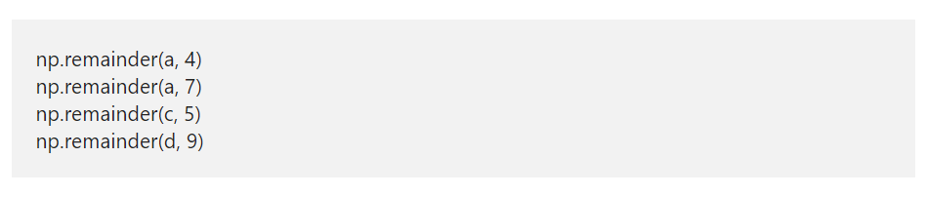
Python numpy remainder function
Similar to mod function, the Python numpy reminder function returns the remainder of the arithmetic division.

Slide 30
Python numpy Comparison Operators
The Python numpy comparison operators and functions used to compare the array items and returns Boolean True or false. The Python Numpy comparison functions are greater, greater_equal, less, less_equal, equal, and not_equal. Like any other, Python Numpy comparison operators are <, <=, >, >=, == and !=
To demonstrate these Python numpy comparison operators and functions, we used the numpy random randint function to generate random two dimensional and three-dimensional integer arrays.
The first array generates a two-dimensional array of size 5 rows and 8 columns, and the values are between 10 and 50.

Slide 31
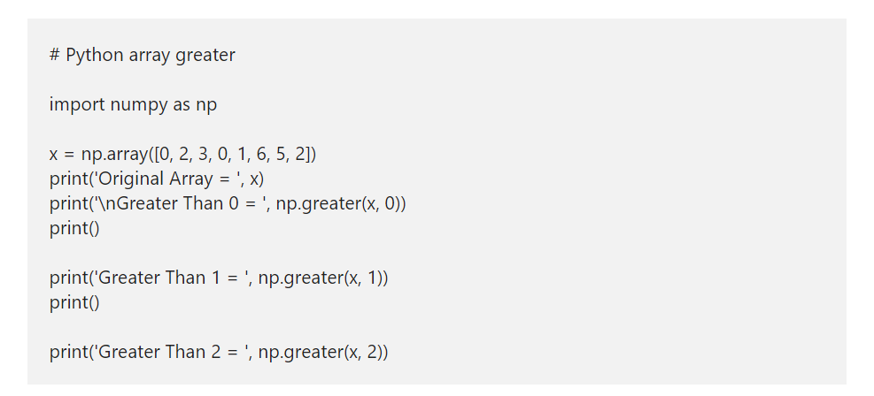
Python numpy Array greater/greater_equal/less/less_equal/equal/ not_equal
It is a simple Python Numpy Comparison Operators example to demonstrate the Python Numpy greater function. First, we declared an array of random elements. Next, we are checking whether the elements in an array are greater than 0, greater than 1 and 2. If True, True returned otherwise, False returned.

Slide 32
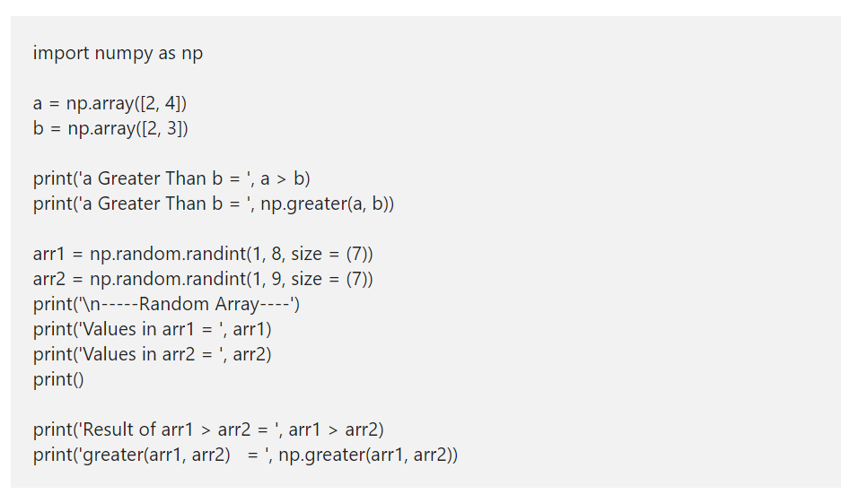
>,>=,<,<=,==,!= Operator
The Python Numpy > Operator is the same as a greater function. Either you can use this to compare each element in an array with a static value, or use this to compare two arrays or matrixes.

Slide 33
Python Numpy alltrue and sometrue functions
The Python Numpy alltrue function is similar to the If statement. If the condition inside this function is true, then True returned otherwise, False. For example, np.alltrue(np.greater(x, 2)) – It returns True if all the elements in x array are greater than 2, then True returned; otherwise, this function return False.
The Python Numpy sometrue function returns true if at least one element in the specified array has to meet the condition otherwise, False. For example, np.alltrue(np.less(x, 3)) – It returns True if at least one element or one array item is less than 3 otherwise, this function return False.

Slide 34
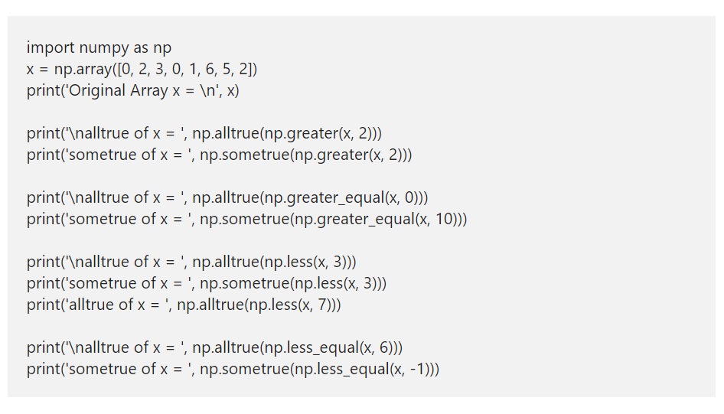

Slide 35
Python random array
In Python, we have the random module used to generate random numbers of a given type using the PRNG algorithm. Here, we are going to discuss the list of available functions to generate a random array in Python.
A pseudorandom number generator (PRNG), also known as a deterministic random bit generator (DRBG),[1] is an algorithm for generating a sequence of numbers whose properties approximate the properties of sequences of random numbers.

Slide 36
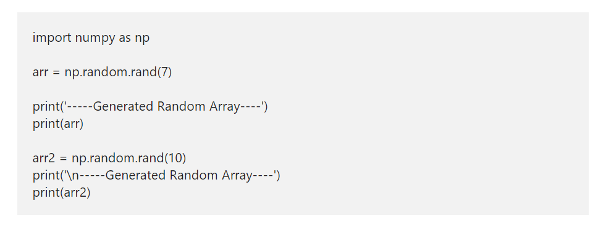
Python random array using rand
The Numpy random rand function creates an array of random numbers from 0 to 1. Here, you have to specify the shape of an array.

Slide 37
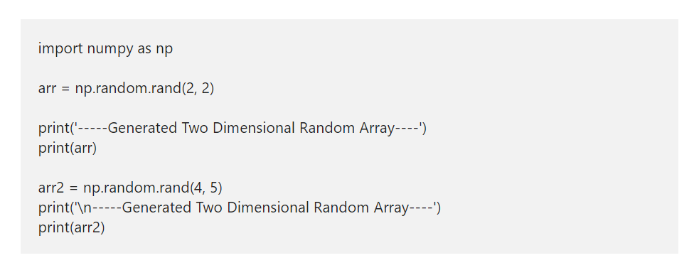
Python numpy 2D Random Array

Slide 38
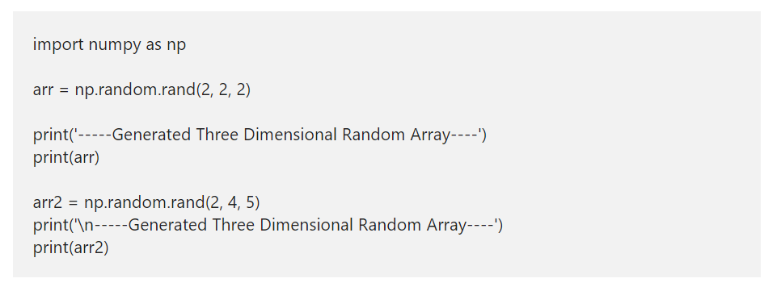
Python Numpy 3D Random Array

Slide 39
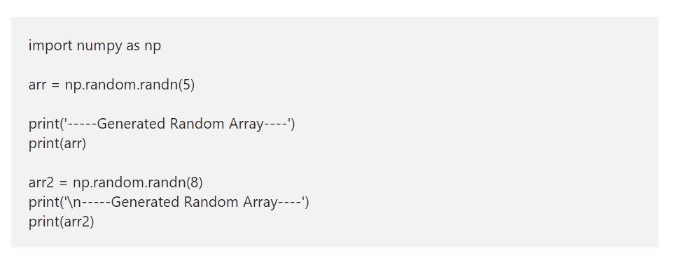
Python numpy random randn

Slide 40
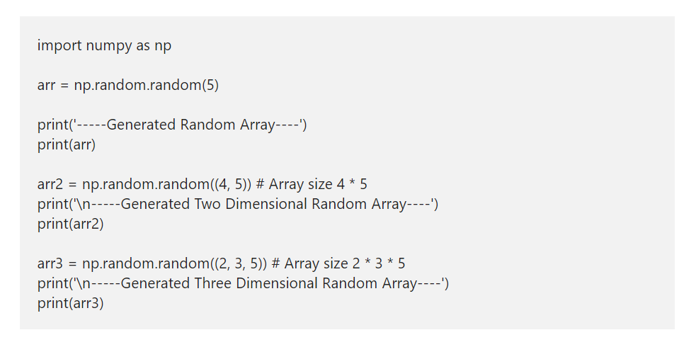
numpy Array using random function

Slide 41
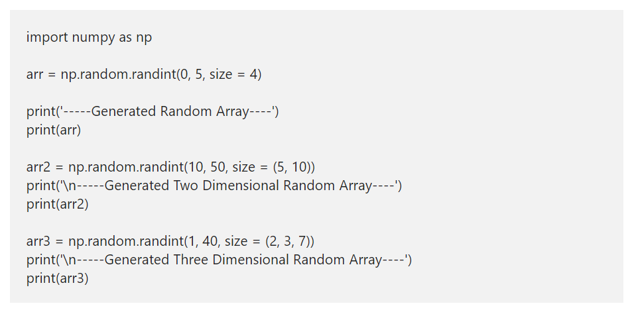
Python Numpy random randint
The Numpy random randint function returns an integer array from low value to high value of given size. The syntax of this Numpy function in Python is.

Slide 42
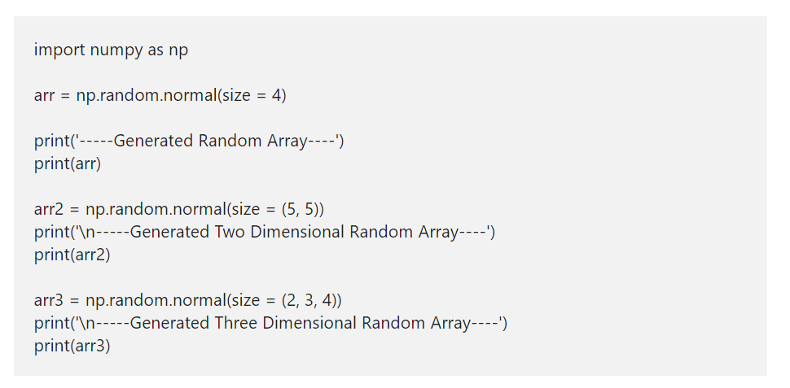
Python Numpy random normal
The Python Numpy random normal function generates numbers from a normal distribution. This Numpy normal accepts the size of an array then fills that array with normally distributed values.

Slide 43
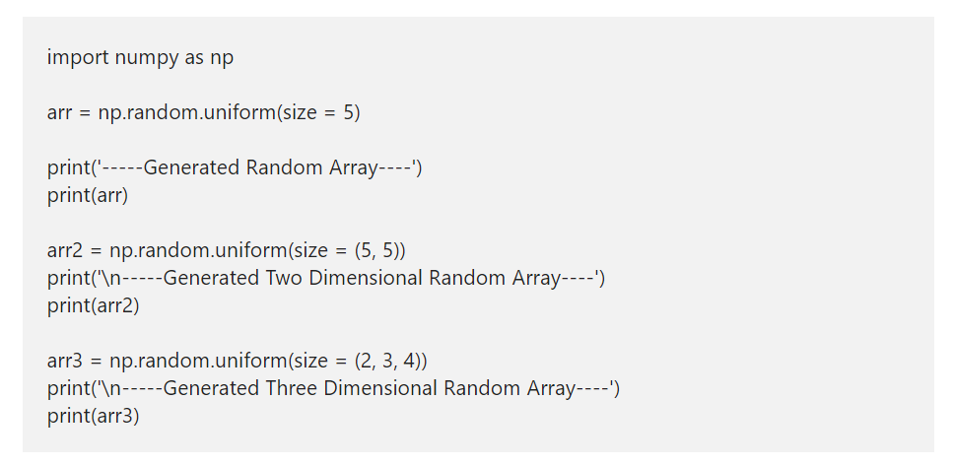
Python Numpy random uniform
The Python Numpy random uniform function generates a uniform distribution of numbers. This uniform accepts the array size and fills that array with uniform distributed values.

Slide 44
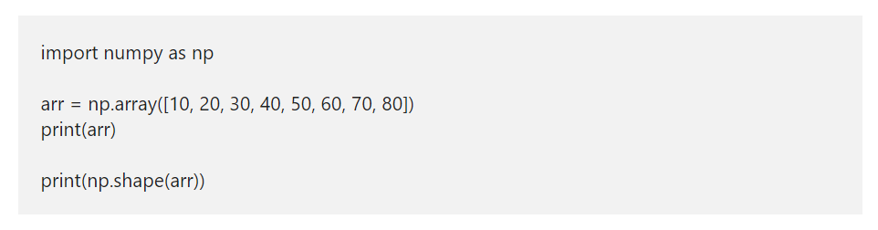
Python numpy Array shape
The Python numpy module has a shape function, which helps us to find the shape or size of an array or matrix. Apart from this shape function, the Python numpy module has reshape, resize, transpose, swapaxes, flatten, ravel, and squeeze functions to alter the matrix of an array to the required shape.

Slide 45
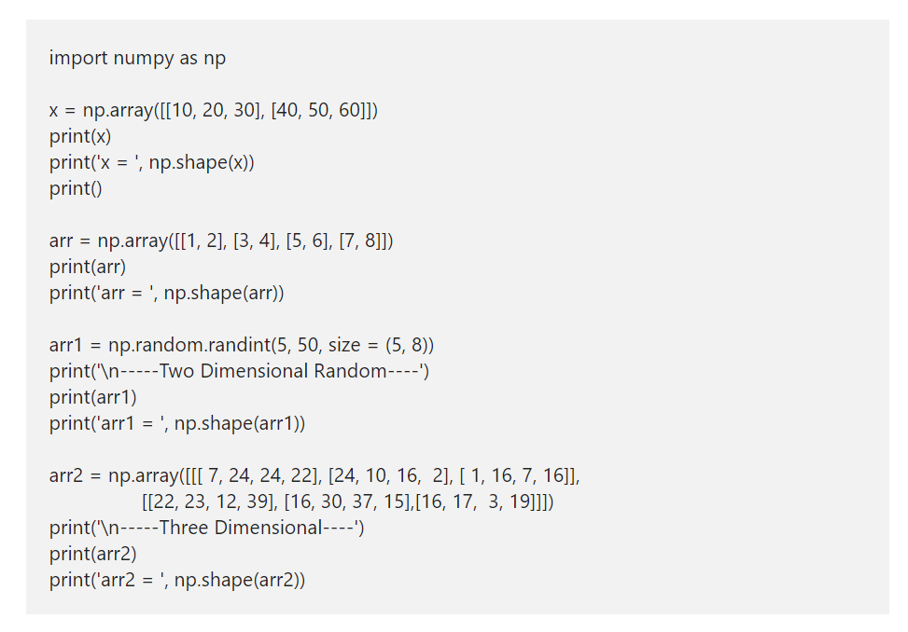

Slide 46
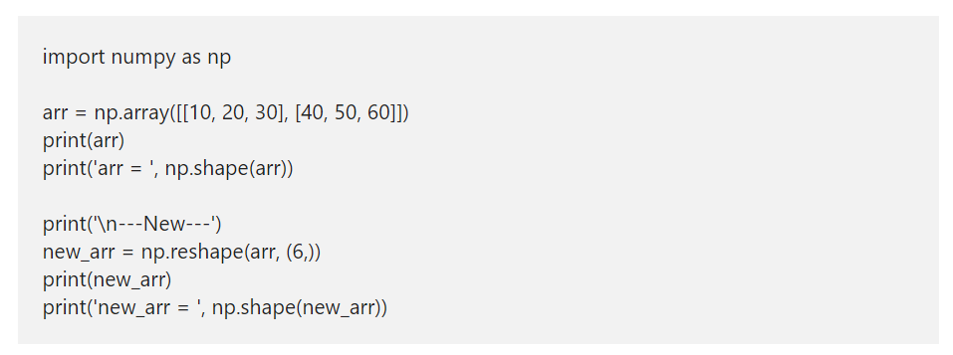
Python numpy Array reshape
The Numpy reshape function accepts an array as the first argument and shape or matrix size as the second argument.

Slide 47
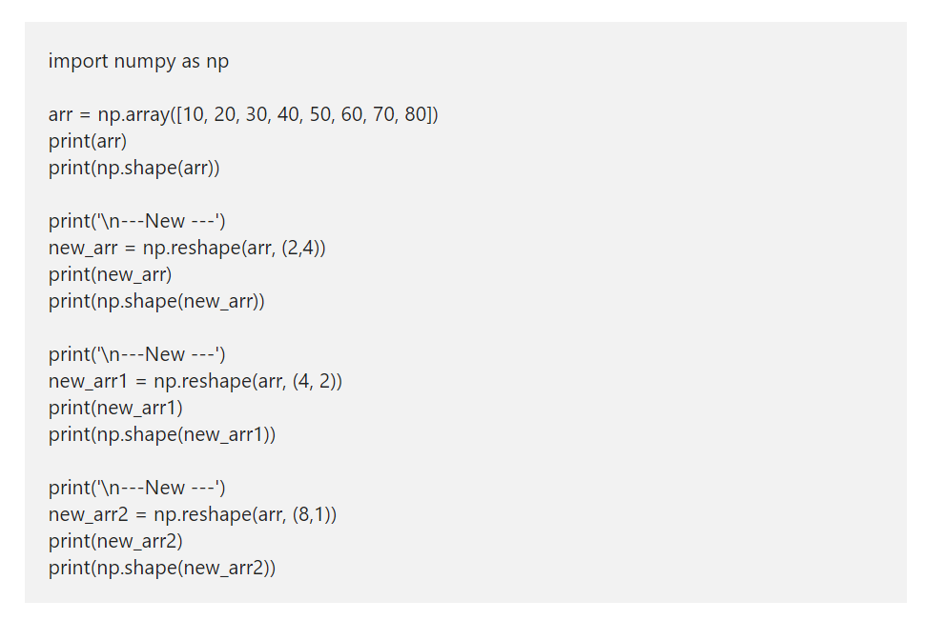

Slide 48
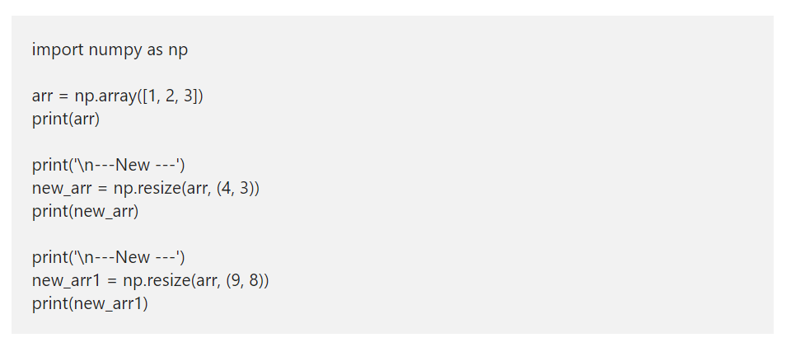
Python numpy Array resize
The Python resize function is useful to resize the existing numpy array to the desired shape. This function accepts an array as the first argument and the desired shape size as a second argument. If you specify the desired shape larger than the original, the Numpy array resize function replicates the values in the base array to create a big array.

Slide 49
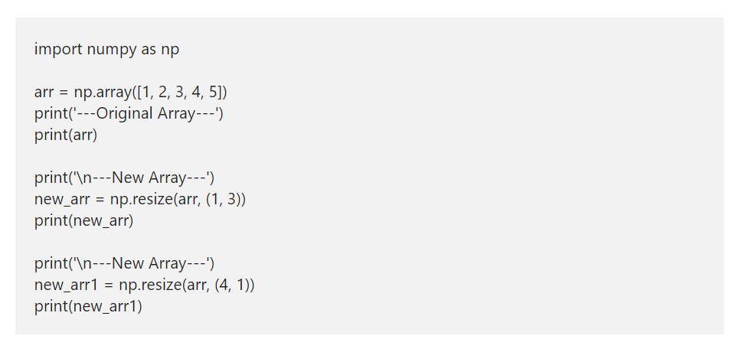

Slide 50
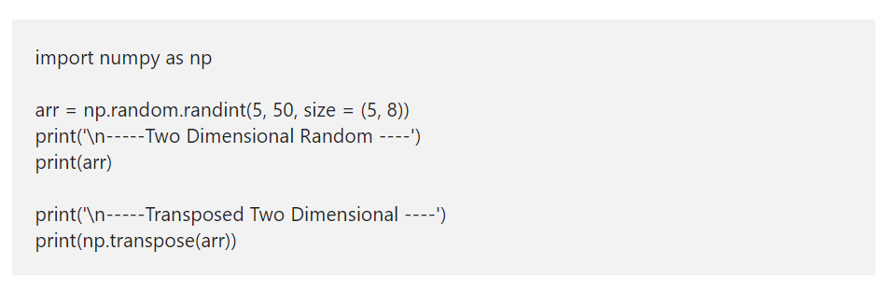
numpy transpose
The transpose function helps you to transpose the given matrix or 2D.

Slide 51
Python numpy Array flatten
The Python flatten function collapses the given array into a one-dimensional. This Python Numpy array flatten function accepts order parameters to decide the order of flattening items.
order = {C, F, A, K} – You can use one of them, or it considers C because it is the default one. C means items will flatten in row-major order. F means Fortran style or column major order. If the array is Fortran contiguous, A flattens in column major order otherwise, row-major order. K flattens in the order of elements occurred in memory.

Slide 52
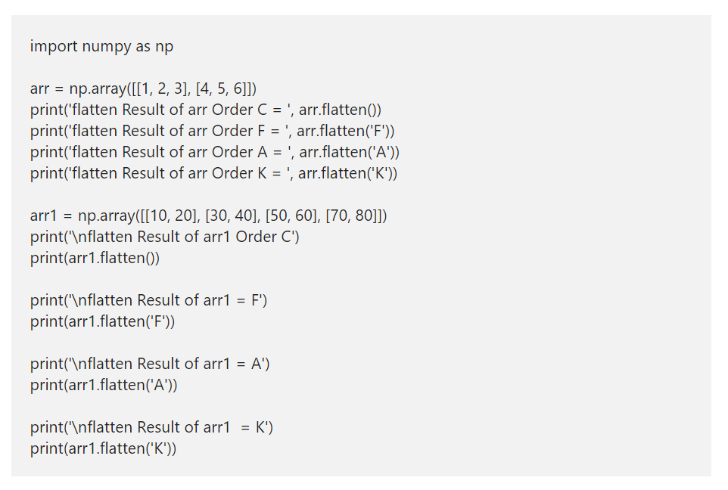

Slide 53
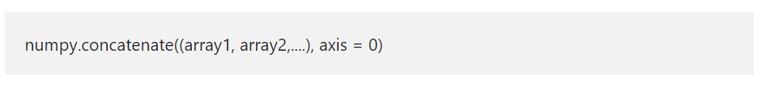
Python numpy concatenate
The Python numpy concatenate function used to Join two or more arrays together and returns the ndarray as an output. The syntax of the Python numpy concatenate function is
array1, array2,… are the arrays that you want to combine. The arrays that you pass to this function must have the same shape. However, you can choose the arrays with different dimensions.
axis – This is an optional argument with default value as 0. Use this to specify in which way (horizontal or Vertical) concatenation should be done.

Slide 54
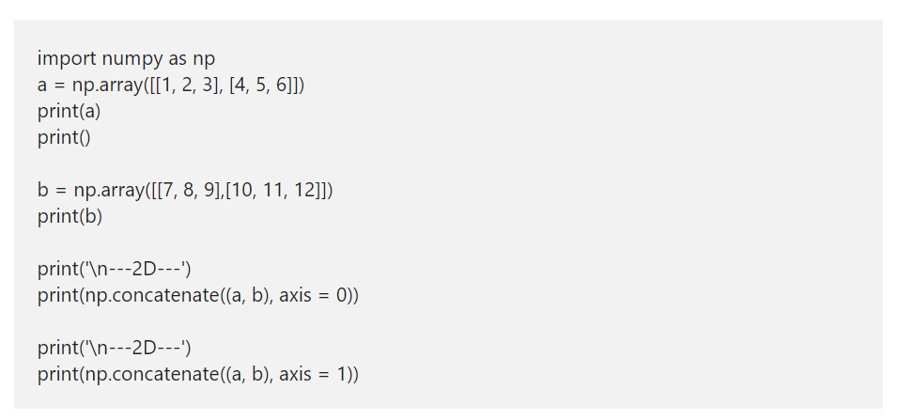
numpy concatenate 2D array with axis
Until now, we are using this method without an axis parameter. This time, we use this parameter value while combining two-dimensional arrays. Remember, If axis = 0, then the items in b are vertically appended to a. Whereas axis = 1 horizontally appends items in b to a.

Slide 55
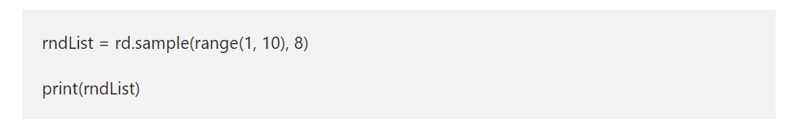
Python Random Number Generator
The random() function generates a number between 0 and 1, and the data type will be float. So the below python number generator example returns a random floating point numbers from 0 to 1.
The randint() function takes two arguments. First argument is the start value, second argument is the stop value. Here, the start is 0 and the stop is n.
The Python random module includes a sample() that allows you to select one or more elements from a list or a tuple. You can use the choice function to select one element from a sequence. To use this, pass in a sequence, along with a sample size (how many elements to sample).

Slide 56
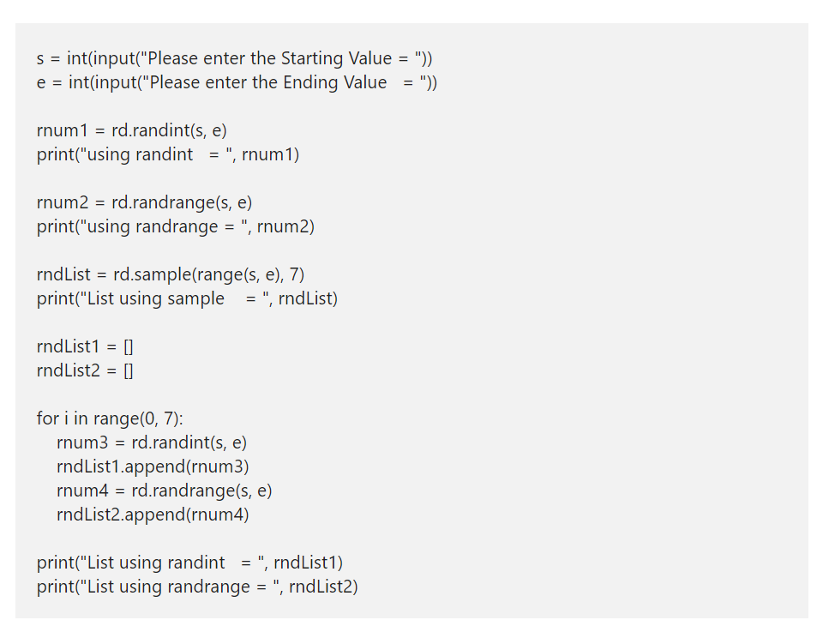

Slide 57
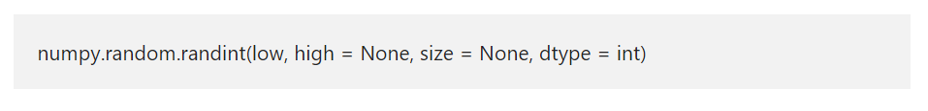
Python numpy random randint
The Python numpy random randint function returns or generates random integer values from the start (low) to end (high). The syntax of the Python numpy random randint function is

